Slide 1
Statistical Reconstruction of Class Hierarchies in Binaries
Omer Katz
Technion, Israel
27/03/2018
Joint work with Noam Rinetzky and Eran Yahav

Slide 2
“Class Hierarchy Reconstruction”?
Given a stripped binary
No source code
No names
No debug symbols
Recreate the class hierarchy
As it was in the source code
Binary

Slide 3
Why should you care?
Reverse engineering
Improve analysis results
Security

Slide 4
Control Flow Integrity (CFI)
Given an indirect jump, guarantee the program jumps only to valid locations
Class hierarchy is required when dealing with virtual function calls
Q: “which types inherit from type t?”

Slide 5
Control Flow Integrity
$$o.f()$$
$o$ is an object, $f$ is a virtual function
Target of call is determined by runtime type of $o$
Valid targets derived from set of valid runtime types
Knowing that $A$ and $C$ are related is not the same as knowing the hierarchy
A
B
C
D
E

Slide 6
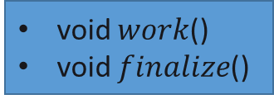
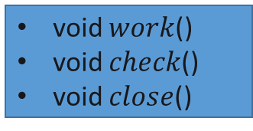
Example
Source code class hierarchy
$$RootClass$$
void $work$()
$$InheritingClass_{1}$$
$$InheritingClass_{2}$$
void $work$()
void $check$()
void $close$()
void $work$()
void $finalize$()

Slide 7
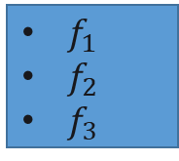
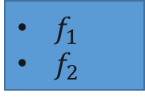
Example
$$Class_{1}$$
$f_{1}$
$$RootClass$$
void $work$()
$$Class_{2}$$
$f_{1}$
$f_{2}$
$f_{3}$
$$InheritingClass_{1}$$
$$InheritingClass_{2}$$
void $work$()
void $check$()
void $close$()
void $work$()
void $finalize$()
$$Class_{3}$$
$f_{1}$
$f_{2}$

Slide 8




Example
code section
$$Func \\ Impl_{1}$$
After stripping:
All constructors/destructors are inlined
$$Class_{1}$$
$f_{1}$
$$Class_{2}$$
$$Func \\ Impl_{2}$$
$f_{1}$
$f_{2}$
$f_{3}$
$$Func \\ Impl_{3}$$
$$Class_{3}$$
$f_{1}$
$f_{2}$
$$Func \\ Impl_{4}$$

Slide 9
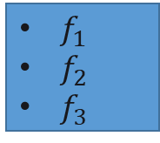
Example
Convert to graph
16 possible hierarchies
$$Class_{1}$$
$f_{1}$
$$Class_{2}$$
$$Class_{3}$$
$f_{1}$
$f_{2}$
$f_{3}$
$f_{1}$
$f_{2}$

Slide 10
Simplifying the graph
Take advantage of any existing structural features
Simplify graph by eliminate “impossible” edges
Structural cues don’t necessarily exist
Optional optimization step

Slide 11

Example
Simplify the graph:
$Class_{1}$ has no possible parent
$Class_{3}$ has only one possible parent ($class_{1}$)
$$Class_{1}$$
$f_{1}$
$$Class_{2}$$
$$Class_{3}$$
$f_{1}$
$f_{2}$
$f_{3}$
$f_{1}$
$f_{2}$

Slide 12
Example
Simplify the graph:
$Class_{1}$ has no possible parent
$Class_{3}$ has only one possible parent ($class_{1}$)
$$Class_{1}$$
$f_{1}$
$$Class_{2}$$
$$Class_{3}$$
$f_{1}$
$f_{2}$
$f_{3}$
$f_{1}$
$f_{2}$

Slide 13




Example
Only 2 hierarchies remaining:
This is where existing techniques stop!
$$Class_{1}$$
$$Class_{1}$$
$$Class_{2}$$
$$Class_{3}$$
$$Class_{3}$$
$$Class_{2}$$

Slide 14

Example
Focus on $Class_{2}$:
$$Class_{1}$$
$f_{1}$
$$Class_{2}$$
$$Class_{3}$$
$f_{1}$
$f_{2}$
$f_{3}$
$f_{1}$
$f_{2}$

Slide 15
From graph to tree
A
B
Graph of possible parents
Need to find most-likely hierarchy from graph
Weighted Arborescence
Directed spanning tree
Tree weight corresponds to likelihood
Edmonds’ algorithm
min-weight arborescence
Edge weights should capture parent-likelihood
$w(B→A)$ = likelihood that $A$ is parent of $B$
C
D
A
A
A
B
B
B
C
C
D
C
D
D

Slide 16
Overview
Combine static analysis with statistical techniques
binary
1
2
3
Extract type behaviors
Train models
Measure similarity
Find most-likely hierarchy

Slide 17
Representing a type
1
Types defined by their sets of usages
A type is not what it can do, but what it actually does
For each type extract usage sequences from binary
$$W\left(16\right)→R\left(0\right)→C\left(0\right)→R\left(8\right)$$
$W$rite field at offset $x$
$R$ead field at offset $x$
$C$all virtual function at offset $x$
etc…
Usages referred to as tracelets

Slide 18
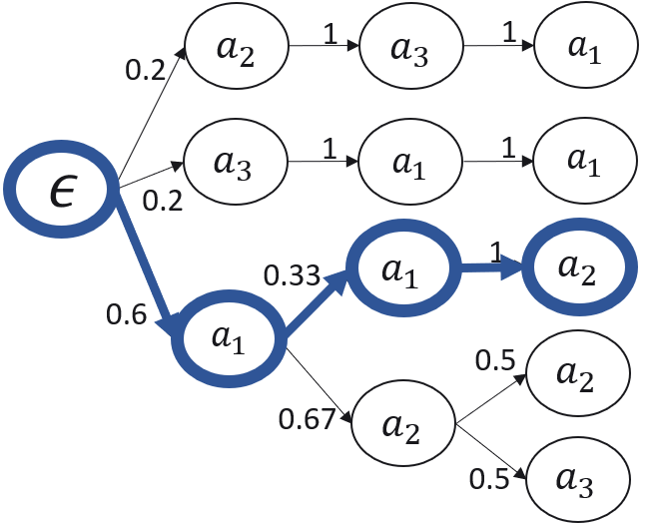
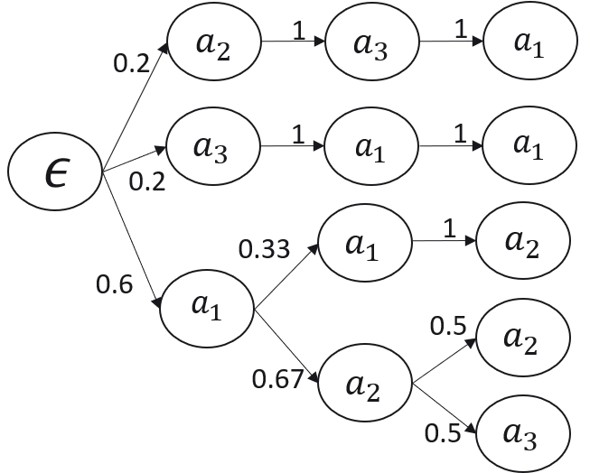
Representing a type
2
Set of tracelets describes legal usages of type t
Represent a type as a Statistical Language Model (SLM)
Train model for each type
Use Prediction by Partial Match
Simple model
Given sequences, build trie
Query model by traversing trie

Slide 19

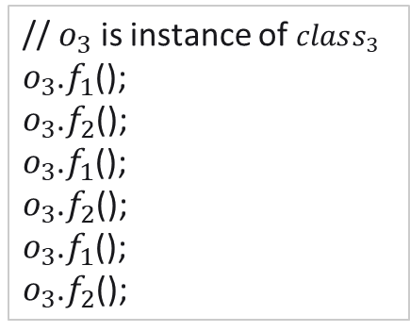

Example
Somewhere in binary we find these code blocks:
Resulting in the following tracelets:
// $o_{1}$ is instance of $class_{1}$
$o_{1}$.$f_{1}$();
$o_{1}$.$f_{1}$();
$o_{1}$.$f_{1}$();
// $o_{2}$ is instance of $class_{2}$
$o_{2}$.$f_{1}$();
$o_{2}$.$f_{1}$();
$o_{2}$.$f_{1}$();
$o_{2}$.$f_{2}$();
$o_{2}$.$f_{3}$();
// $o_{3}$ is instance of $class_{3}$
$o_{3}$.$f_{1}$();
$o_{3}$.$f_{2}$();
$o_{3}$.$f_{1}$();
$o_{3}$.$f_{2}$();
$o_{3}$.$f_{1}$();
$o_{3}$.$f_{2}$();
$$Class_{1}:$$
$$Class_{2}:$$
$$Class_{3}:$$
$$f_{1}$$
$$f_{1}$$
$$f_{1}$$
$$f_{1}$$
$$f_{1}$$
$$f_{1}$$
$$f_{2}$$
$$f_{3}$$
$$f_{1}$$
$$f_{2}$$
$$f_{1}$$
$$f_{2}$$
$$f_{1}$$
$$f_{2}$$

Slide 20
From behavior to type similarity
3
Given the same query, 2 SLMs trained using similar set of tracelets should produce similar probabilities
$$C_{1}=\left\{a→a→a,a→a→b\right\}$$
$$C_{2}=\left\{a→a→a,a→a→c\right\}$$
$$C_{3}=\left\{a→b→c,a→c→b\right\}$$
$$q=a→a→a$$
$$Pr_{C_{1}}\left(q\right)−Pr_{C_{2}}\left(q\right)<Pr_{C_{1}}\left(q\right)−Pr_{C_{3}}\left(q\right)$$

Slide 21
From behavior to type similarity
3
Hypothesis: SLMs of related types should be more similar than SLMs of unrelated types
Why?
Inheriting types also inherit all legal usages
Set of tracelets would be contained in each other
$B$ inherits from $A⇒Tr_{A}⊆Tr_{B}$
$Tr_{x}$ = set of tracelets for type $x$

Slide 22
From behavior to type similarity
3
Kullback-Leibler divergence ($D_{KL}$) measures similarity between SLMs
$${\text{D}}_{\text{KL}}\left(\text{A}\text{∥}\text{B}\right)\text{=}{\text{Σ}}_{\text{w}\text{∈}\text{W}}\left(\text{P}{\text{r}}_{\text{A}}\left(\text{w}\right)\text{⋅}\ln\left(\frac{\text{P}{\text{r}}_{\text{A}}\left(\text{w}\right)}{\text{P}{\text{r}}_{\text{B}}\left(\text{w}\right)}\right)\right)$$
Compute difference in the average number of bits needed to encode $W$ using the 2 SLMs
$W$ is the set of tracelets used to train $A$
Asymmetric measure
We Use $D_{KL}$ as weights

Slide 23

Example
After training models and computing $D_{KL}$:
$D_{KL}\left(M_{Class_{2}}∥M_{Class_{1}}\right)=0.07$
$D_{KL}\left(M_{Class_{2}}∥M_{Class_{3}}\right)=0.21$
$$Class_{1}$$
$f_{1}$
$$0.07$$
$$Class_{2}$$
$$Class_{3}$$
$f_{1}$
$f_{2}$
$f_{3}$
$f_{1}$
$f_{2}$
$$0.21$$

Slide 24
Example
Minimum-weight arborescnce:
Same as original class hierarchy!
$$Class_{1}$$
$f_{1}$
$$Class_{2}$$
$$Class_{3}$$
$f_{1}$
$f_{2}$
$f_{3}$
$f_{1}$
$f_{2}$

Slide 25
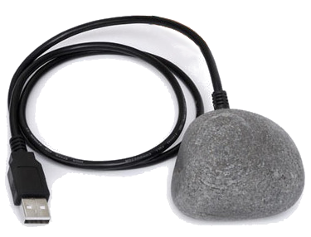
Evaluation
Implemented in a tool called ROCK
Reconstruction Of Class Khierarchies
Aimed at C++ binaries for windows
Common case in which source code is not available
Ground truth Automatically obtained from source code and debug information
Visualization of ROCK 2.0

Slide 26
Evaluation
Focus on CFI scenario
Q: which types inherit from type t?
A: set of types
Additional types $≈$ false positives ($≈$ precision)
Missing types $≈$ false negatives ($≈$ recall)

Slide 27
Evaluation
More benchmarks in the paper

Slide 28
Evaluation
Presented results only use first arborescence
Using several arborescences reduces missing types but increases additional types
Tradeoff between false positives and false negatives

Slide 29
Summary
Reconstruct an actual hierarchy
Not just a partial hierarchy
Without relying on optional information
Convert hierarchy reconstruction to graph problem
Weighted arborescence
Relies on usage patterns and model similarity
Tracelets, SLMs and Kullback-Leibler divergence
Can provide stricter CFI policies

Slide 30
Questions?
Thank you for listening
The research leading to the results presented in this paper is partially supported by the European Union’s Seventh Framework Programme (FP7) under grant agreement no. 615688 (PRIME) and the Israel Science Foundation grant no.1319/16.

Slide 31
echoparams
Only 4 types
Only 1 type family
Only 58 Kb of code
Seems easy right?
NO
All these parameters are misleading

Slide 32
echoparams
All types “seem” structurally the same
Same virtual functions table size
Same fields
etc…
If looking at types as sets of actions (without order), all types look the same

Slide 33
echoparams
Existing techniques can’t eliminate any possible hierarchy
Using usage tracelets and model similarity we can perfectly recreate the hierarchy

Slide 34
Error sources
Other than choosing a wrong parent for a type
Optimizations resulting in virtual function tables of unrelated types containing a pointer to the same virtual function
Results in additional types
Omitting a whole class from the binary as an optimization
Results in missing types
Both errors also affect traditional techniques

Slide 35
Multiple Inheritance
Usually relatively easy to detect if type as several parents based on object initialization, layout, etc…
Usually we choose only a single parent per type
If type should have $n$ parents, choose $n$ most likely parents

Slide 36
Existing techniques
Can’t guarantee a full hierarchy
Only partial hierarchies, gaps remaining
Rely on “structural” cues
Cues can be omitted
Inlining calls to parent constructors

