Slide 1
Estimating Types in Binaries using Predictive Modeling
Omer Katz, Ran El-Yaniv, Eran Yahav
Technion, Israel
21/01/2016

Slide 2
You get new binaries everyday…
Most software reaches users as binaries
Usually stripped
Check for vulnerabilities in the software
Reverse engineering is used for software security
Very difficult and tedious

Slide 3
Reverse Engineering (RE)
Statically understand control flow of program
Calls to virtual functions
Statically unknown target
Given a stripped binary, Rank the most likely targets for each virtual call
Binary
5
f1
f2
3
f3
1
?
2
f5
4
f4
call eax

Slide 4
Virtual function calls and objects
Virtual call applied to an object
Target determined by object’s runtime type
Rank most likely types for each object
Deduce ranking of targets

Slide 5
Virtual function calls and objects
Virtual call applied to object o
Labeled objects
Known type
Single target
Binary
f1
f2
f3
?
f5
Types
$$∋$$
O
call eax
f4
type3

Slide 6
Virtual function calls and objects
Unlabeled objects
Unknown type
Many possible targets
Binary
5
f1
f2
3
Types
…
f3
5
type1
3
type2
1
2
f5
1
type3
4
O
$$∋$$
O
call eax
4
f4
type4
2
type5

Slide 7
Our approach
Different types are used differently
Rely on combination of Program Analysis and Machine Learning
Program analysis extracts usage profiles of objects
Machine learning predicts type of object based on usage
prediction
Ranked list of targets per call site
Tracelets per object with unknown type
Query SLM
output
Stripped binary
Program Analysis
Tracelets per object with known type
Train SLM
SLM
input
Extracting tracelets
training

Slide 8
Extracting usages
…
mov ebx,[ecx]
mov edx,[ebx+04h]
call edx
call edx is a virtual function call
loop:
mov [eax+10h],1
mov ebx,[eax]
mov edx,[ebx]
call edx
mov ebx,[eax+08h]
cmp ebx,0
jz loop
mov [ecx+0ch],ebx
…
Win 32-bit x86 assembly

Slide 9
Extracting usages
…
mov ebx,[ecx]
mov edx,[ebx+04h]
call edx
call edx is a virtual function call
edx is [[eax]]
loop:
mov [eax+10h],1
mov ebx,[eax]
mov edx,[ebx]
call edx
mov ebx,[eax+08h]
cmp ebx,0
jz loop
Memory:
object:
Registers:
eax
vtable address
field 1
field 2
…
vfunc 1
vfunc 2
vfunc 3
…
ebx
edx
mov [ecx+0ch],ebx
…
Win 32-bit x86 assembly

Slide 10
Usage profiles
High-level usage of objects
Intra-procedural sequences of actions
Tracked actions:
R(x) – field in offset x is read
W(x) – field in offset x is written
C(x) – the x’th virtual function is called
etc…

Slide 11
Extracting usages
…
mov ebx,[ecx]
mov edx,[ebx+04h]
call edx
$$R_{ecx}(0)$$
$$C_{ecx}(4)$$
Object pointers in the code
eax
ecx
Track actions on objects
eax: $W\left(16\right)→R\left(0\right)→C\left(0\right)→R\left(8\right)$
ecx: $R\left(0\right)→C\left(4\right)→W(12)$
loop:
mov [eax+10h],1
mov ebx,[eax]
mov edx,[ebx]
call edx
mov ebx,[eax+08h]
cmp ebx,0
jz loop
$$W_{eax}(16)$$
$$R_{eax}(0)$$
$$C_{eax}(0)$$
$$R_{eax}(8)$$
$$→$$
$$W_{edx}(12)$$
mov [ecx+0ch],ebx
…
Win 32-bit x86 assembly

Slide 12
From usages to tracelets
Split sequences to tracelets
Subsequences of fixed-length
Exhaustively repeat loops
$$W\left(16\right)→R\left(0\right)→C\left(0\right)→R\left(8\right)→W\left(16\right)→R\left(0\right)→C\left(0\right)→R\left(8\right)→W\left(16\right)→ …$$
Split to length 5
$$W\left(16\right)→R\left(0\right)→C\left(0\right)→R\left(8\right)→W\left(16\right)$$
$$C\left(0\right)→R\left(8\right)→W\left(16\right)→R\left(0\right)→C\left(0\right)$$
$$R\left(0\right)→C\left(0\right)→R\left(8\right)→W\left(16\right)→R\left(0\right)$$
$$R\left(8\right)→W\left(16\right)→R\left(0\right)→C\left(0\right)→R\left(8\right)$$

Slide 13
Obtaining the tracelets
Track objects and actions statically
Use symbolic execution
Represent objects as sets of tracelets

Slide 14
Statistical Language Models (SLMs)
Given a language $L$ with alphabet $Σ$, an SLM $M_{L}$ and sentence $S$ from $Σ^{∗}$, $P_{M_{L}}(s)$ is the probability of $s$ originating from $M_{L}$
For example:
$P_{M_{English}}\left(\text{I} \text{am} \text{giving} \text{this} \text{talk}\right)>P_{M_{English}}\left(\text{this} \text{talk} \text{giving} \text{I} \text{am}\right)$
$P_{M_{Yoda}}\left(\text{I} \text{am} \text{giving} \text{this} \text{talk}\right)<P_{M_{Yoda}}\left(\text{this} \text{talk} \text{giving} I \text{am}\right)$

Slide 15
Variable-order Markov models
N-gram models
Sentences of length n
Variable-order n-gram models
Let the data determine the order
Use high order when possible, lower order otherwise
In our setting:
Alphabet := set of all single actions
Sentences := tracelets
$\text{"}\text{I} \text{am}“$
$\text{"}\text{am} \text{giving}\text{"}$
$\text{"}\text{gi}\text{ving} \text{this}\text{"}$
$\text{"}\text{this} \text{talk}\text{"}$
bi-grams
$\text{"}\text{I} \text{am} \text{giving} \text{this} \text{talk}$”

Slide 16
Training the models
Prediction by Partial Match (PPM)
Originally for compression, useful for prediction
Given sentence “${a_{1}a}_{2}a_{3}a_{1}a_{1}a_{2}a_{2}$”
n-grams (n=3):
$a_{1}a_{2}a_{3}$
$a_{2}a_{3}a_{1}$
$a_{3}a_{1}a_{1}$
$a_{1}a_{1}a_{2}$
$a_{1}a_{2}a_{2}$
In practice a small probability is reserved for the smoothing and back-off mechanism
$$a_{2}$$
1
$$a_{3}$$
1
$$a_{1}$$
0.2
$$a_{3}$$
1
$$a_{1}$$
1
$$a_{1}$$
$ε$
0.2
0.33
$$a_{1}$$
1
$$a_{2}$$
0.6
$$a_{1}$$
$$P\left(a_{1}a_{1}a_{2}\right)=0.2$$
0.5
$$a_{2}$$
0.67
$$a_{2}$$
0.5
$$a_{3}$$

Slide 17
Ranking types
Compute probability for object and type pair
Rank types by probability
For object $o$ and type $t$ $P_{M_{t}}\left(o\right)≔Π_{tr∈Tr\left(o\right)}P_{M_{t}}\left(tr\right)$
$Tr\left(o\right)$ is the set of tracelets for $o$,
Alternative:
Train models for object and measure the distance between models
e.g. using Jensen-Shannon divergence

Slide 18
Evaluation
Binary
5
Evaluated on 20 open source C++ projects
Compiled with default optimizations and stripped
Ground truth determined manually
Evaluate results by rank of expected target
f1
f2
3
f3
1
2
f5
4
f4
call eax

Slide 19
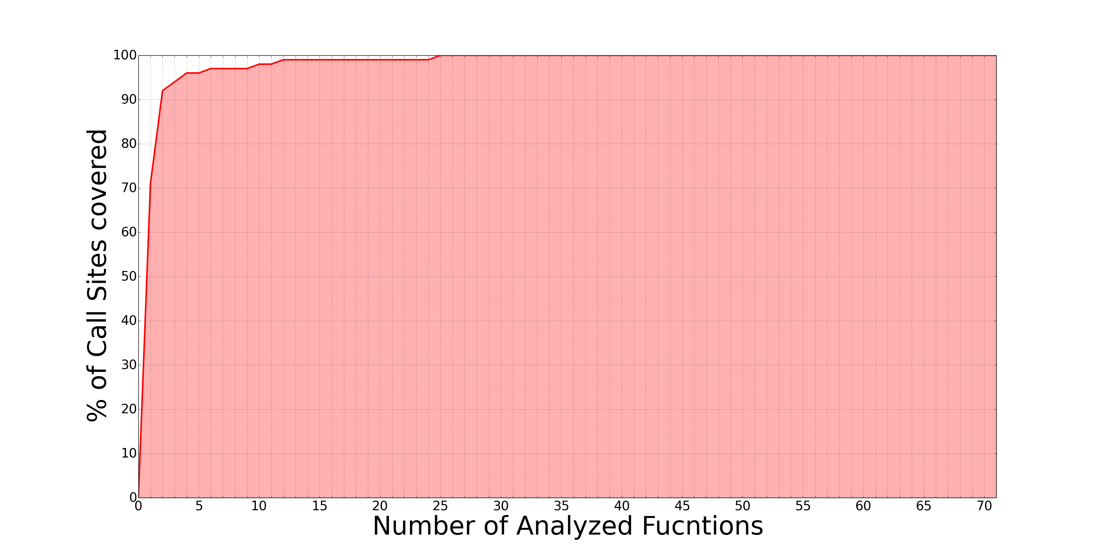
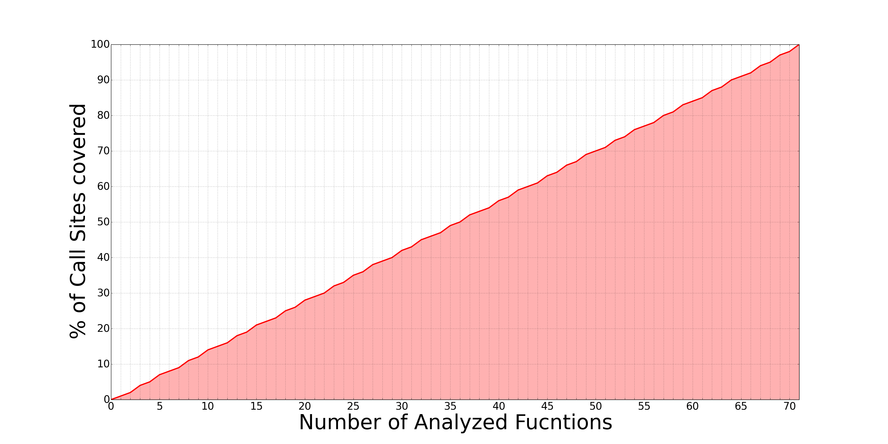
Coverage graphs
2
71
Benchmark name: Smoothing.exe
Top 2 ranked targets => ~92% of calls

Slide 20
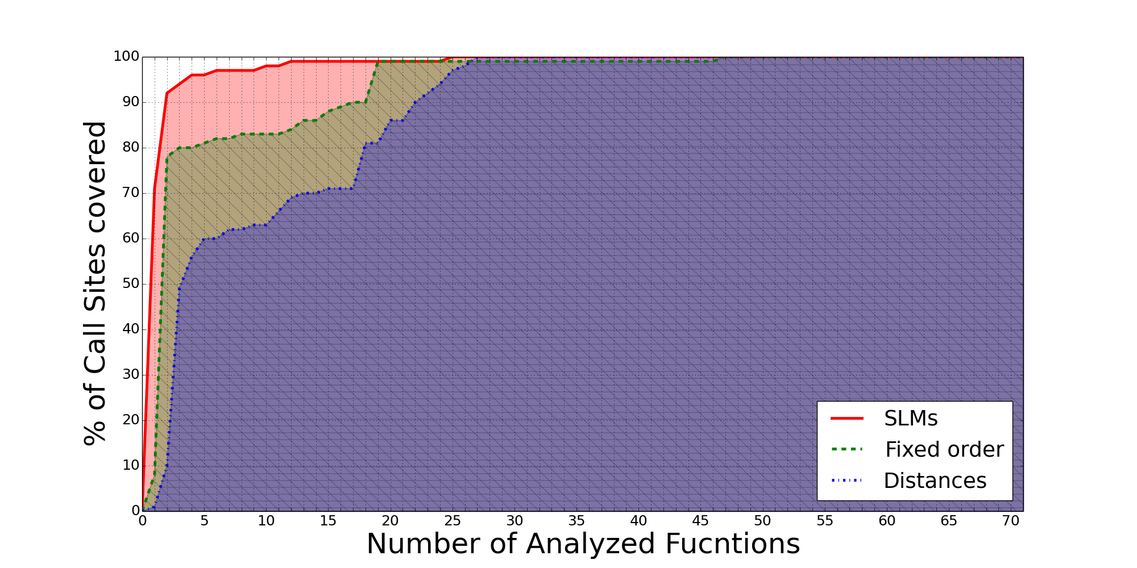
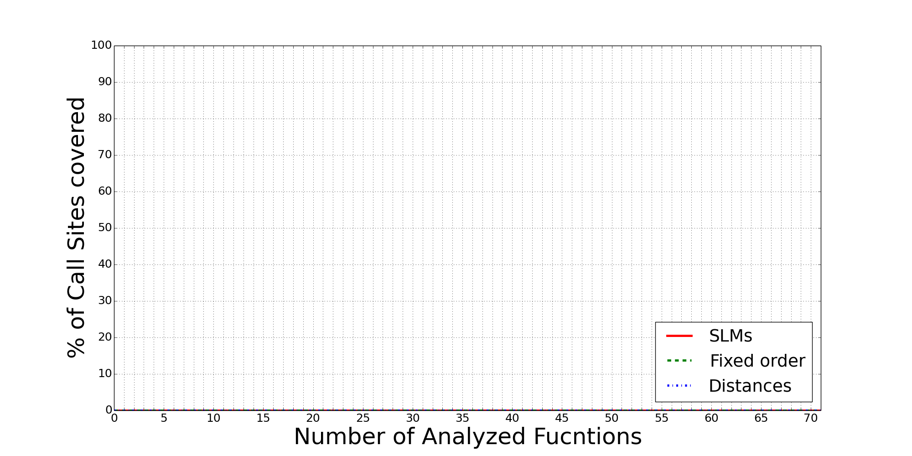
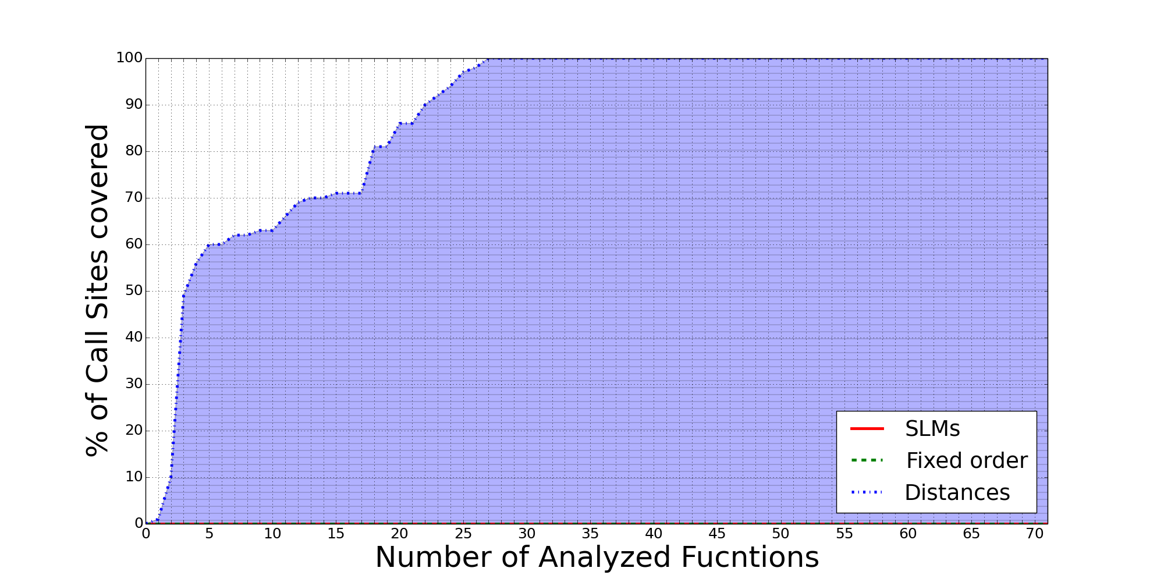
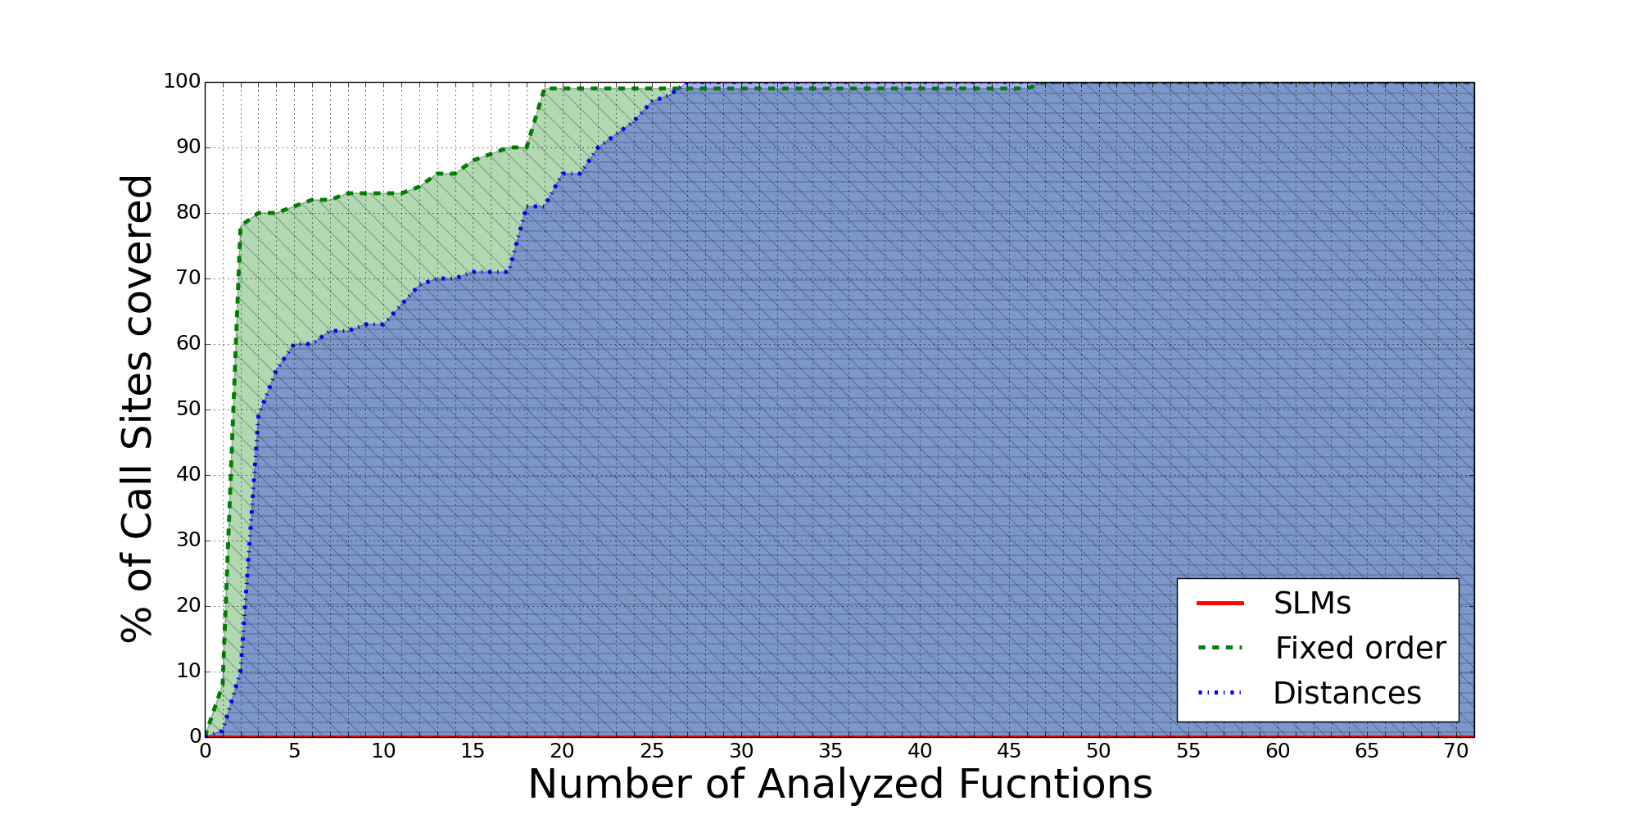
SLMs outperform other models
SLMs requires x9 less targets than fixed-order models and x11 less than edit-distance metrics
2
18
22
Fixed-order models: n-gram model using KT-estimator for smoothing
Edit-distance metrics: based on Levenshtein-Damarau

Slide 21
Summary
Statistical solution to an otherwise extremely difficult problem
Drastically reduce number of targets per virtual call
Across all benchmarks, expected target was ranked among top 3 targets for 80% of virtual calls
Power lies in combination of program analysis and machine learning
Program analysis to extract usage profiles
Machine learning to reason and predict objects’ types

Slide 22
Questions?
Thank you for listening
The research leading to these results has received funding from the European Union's - Seventh Framework Programme (FP7) under grant agreement n° 615688 – ERC- COG-PRIME.

